Slide 1
The Evolution of Traditional to New Media

Slide 2
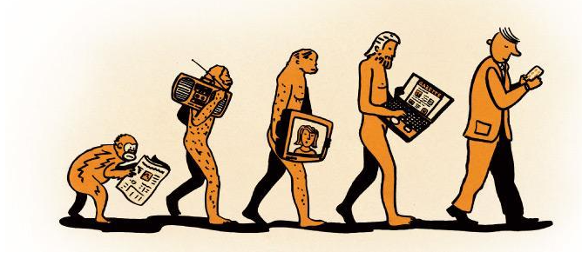
The Evolution of Media

Slide 3
The Evolution of Media
PRE – INDUSTRIAL AGE
INDUSTRIAL AGE
ELECTRONIC AGE
NEW/INFORMATION AGE

Slide 4
PRE-INDUSTRIAL AGE (1500BC)
Prehistory is the period of human activity between the use of the first stone tools ~3.3 million years ago and the invention of writing systems, the earliest of which appeared ~5300 years ago. Technology that predates recorded history.
History is the study of the past using written records; it is also the record itself. Anything prior to the first written accounts of history is prehistoric (meaning "before history"), including earlier technologies.
About 2.5 million years before writing was developed, technology began with the earliest hominids who used stone tools, which they may have used to start fires, hunt, cut food, and bury their dead.

Slide 5
PRE-INDUSTRIAL AGE (1500BC)
People discovered fire, develop paper from plants, and forged weapons and tools with stone, bronze, copper and iron.

Slide 6
PRE-INDUSTRIAL AGE (1500BC)
EXAMPLE FORMS OF MEDIA
CAVE PAINTINGS
CLAY TABLETS IN MESOPOTAMIA
PAPYRUS IN EGYPT
DIBAO IN CHINA
PRINTING PRESS USING WOOD BLOCKS

Slide 7
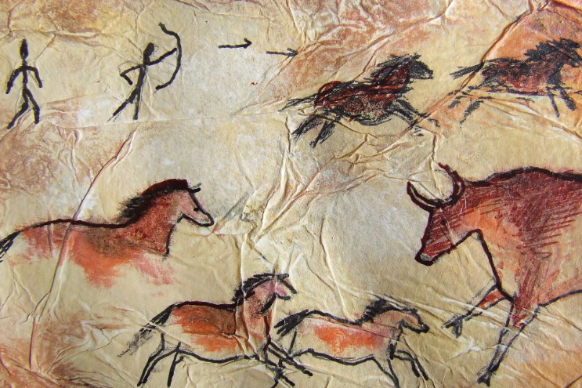
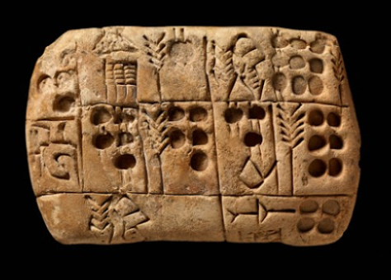
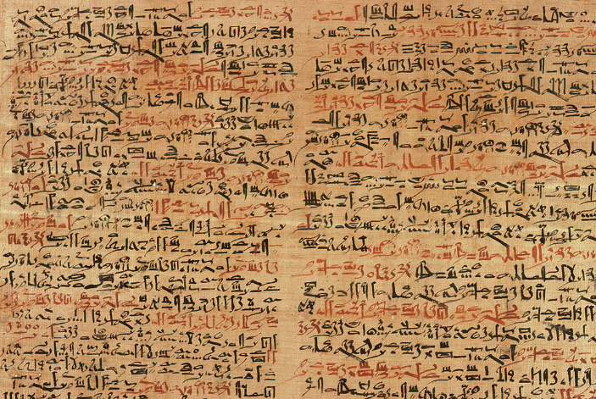

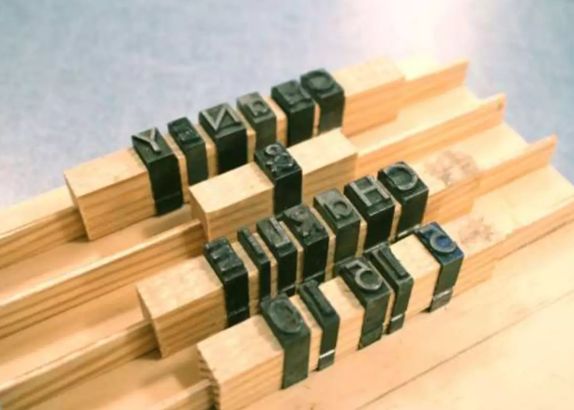

Slide 8
INDUSTRIAL AGE (1700s-1930s)
The Industrial Age is a period of history that encompasses the changes in economic and social organization that began around 1760 in Great Britain and later in other countries, characterized chiefly by the replacement of hand tools with power-driven machines such as the power loom and the steam engine, and by the concentration of industry in large establishments.
People used the power of steam, developed machine tools, established iron production, and the manufacturing of various products (including books using the printing press)

Slide 9
INDUSTRIAL AGE (1700s-1930s)
EXAMPLE FORMS OF MEDIA
Printing Press
Newspaper
Typewriter
Motion picture photography
Telegraph

Slide 10
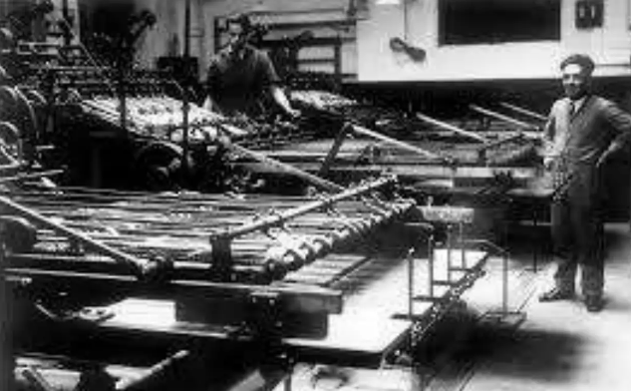
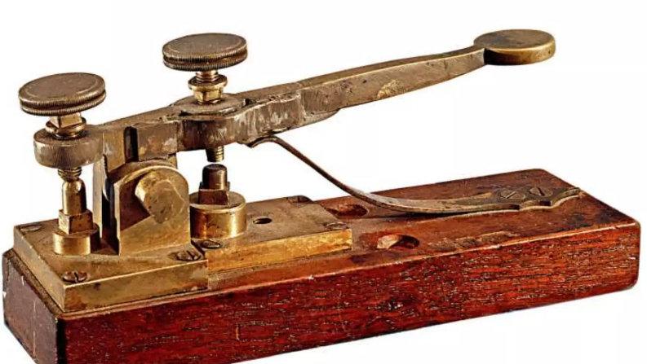
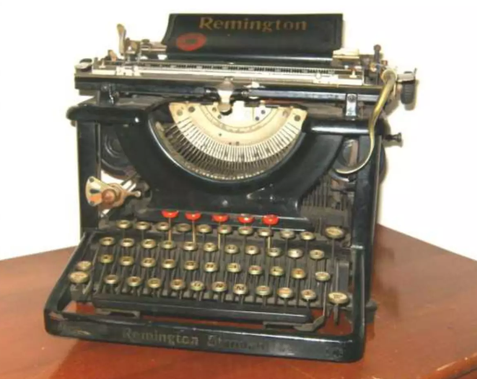
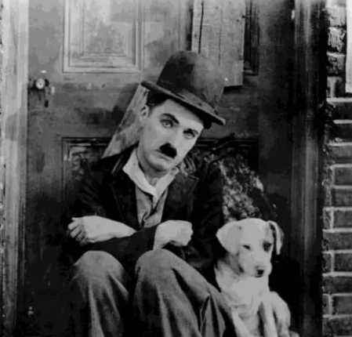
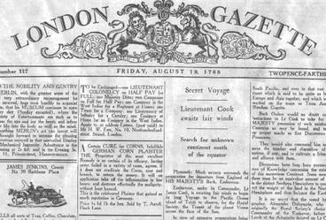

Slide 11
ELECTRONIC AGE(1930s-1980s)
The Electronic age is the invention of the transistor ushered in the electronic age. People harnessed the power of transistor that led to the transistor communication became more efficient.
The invention of the transistor ushered in the electronic age. People harnessed the power of transistor that led to the transistor radio, electronic circuits, and the early computers. In this age, long distance communication become more efficient

Slide 12
ELECTRONIC AGE(1930s-1980s)
EXAMPLE FORMS OF MEDIA
TRANSISTOR RADIO
TELEVISION
COMPUTERS
LCD PROJECTORS

Slide 13
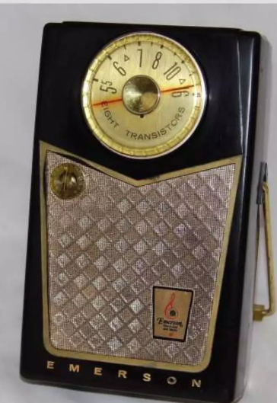
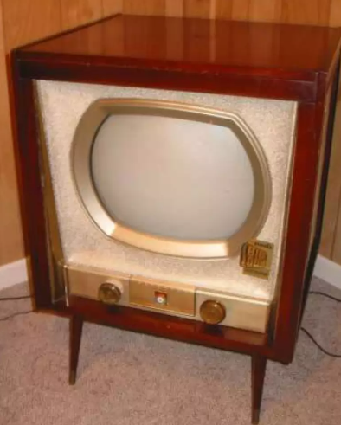
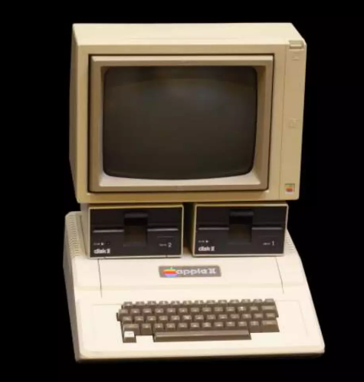
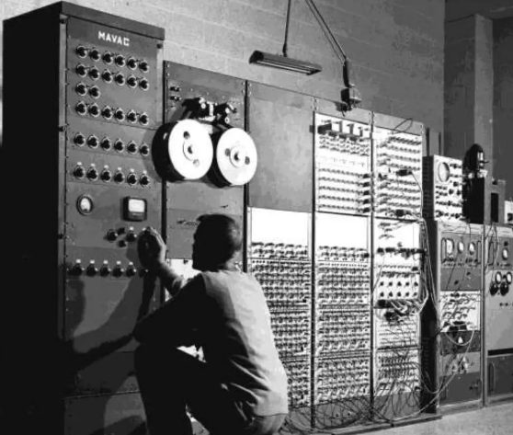

Slide 14
NEW/INFORMATION AGE (1900s-2000s)
Digital Age or Informational Age is a period in human history characterized by the shift from traditional industry that the Industrial Revolution brought through industrialization, to an economy based on information computerization.
The internet paved the way advanced the used of microelectronics with the invention of personal computers, devices wearable technology. Moreover, voice, image, sounds, and data are digitalized.

Slide 15
NEW/INFORMATION AGE (1900s-2000s)
EXAMPLE FORMS OF MEDIA
SOCIAL MEDIA
PORTABLE COMPUTER(LAPTOP)
VR (VIRTUAL REALITY)
INTERNET
WEBSITES

Slide 16
